Slide 1
World's Real Estate Data
Presented by: Fatima ammar
Zahra Hussain
Mariam alkangooni

Slide 2
Problem statement:
Problem statement:
Buyers face significant difficulty comparing apartment and villa prices across different countries due to inconsistent pricing metrics, varying local factors, and a lack of standardized information, making it challenging to understand what influences real estate values globally.
Aim:
To analyze global real estate data and find how location, size, and other features influence property prices, helping buyers make better decisions.

Slide 3
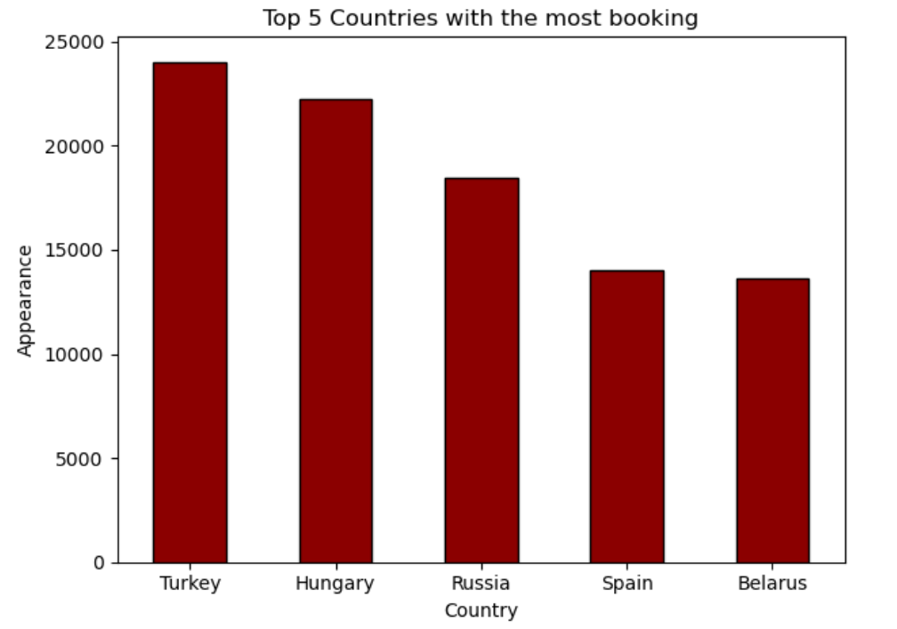
Top 5 Countries with the Most Properties for Sale

Slide 4
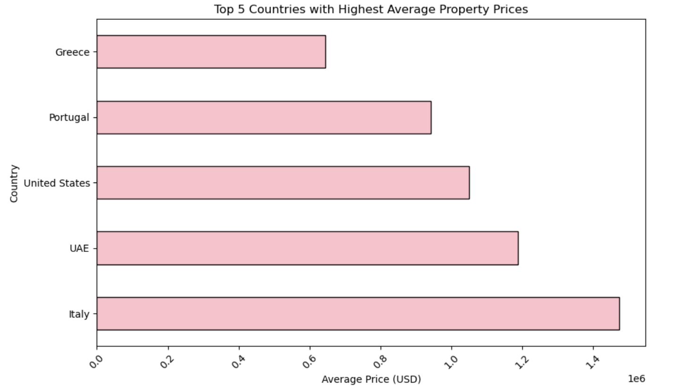
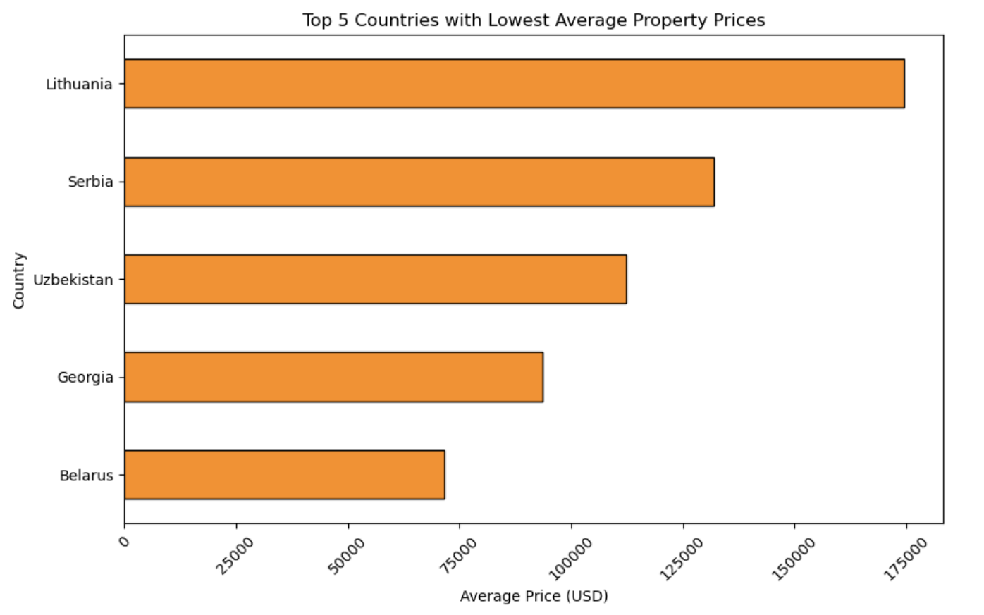
Countries with the Highest and Lowest Average Property Price

Slide 5
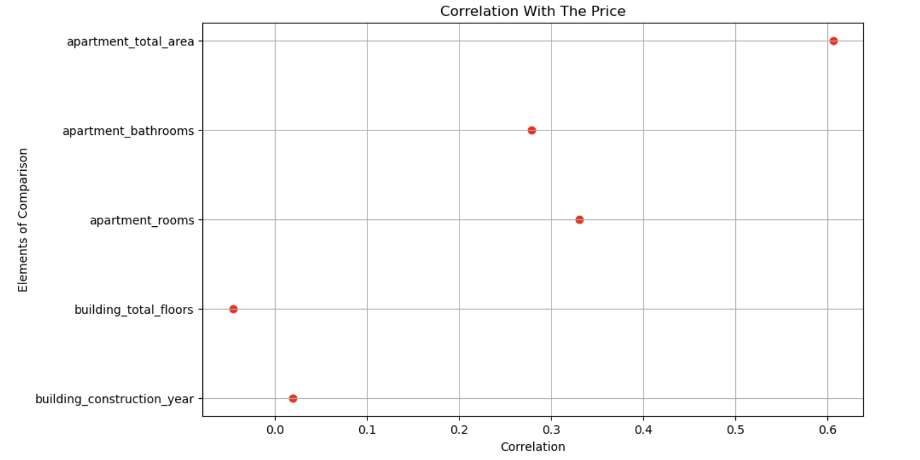
Correlation Between Property Attributes and Price

Slide 6
Recommendations:
• Target countries with lower average property prices for better investment options.
• Look for properties with larger areas and more rooms, as they are usually more valuable.
• Use feature-price correlations to guide property evaluation.
• Always compare prices across countries to spot market differences

Slide 7
Thanks!

